Slide 1

Crime (Los Angeles) Analysis Report

Slide 2
Contents
Problem Statements
Observations based on Problem statements
Insights
Recommendations
Summary

Slide 3
Problem statement
People all throughout Los Angeles are concerned about recent reports of crimes in numerous locations. The mayor of Los Angeles has established a new Criminal Investigation Division to study how and why crime is on the rise, as well as the elements that contribute to it, so that officials may take the necessary steps to keep the city's residents safe.
Which was the most frequent crime committed each week?
Is crime more prevalent in areas with a higher population density, fewer police personnel, and a larger precinct area?
At what points of the day is the crime rate at its peak? Group this by the type of crime.
At what point in the day do more crimes occur in a different locality?
Which age group of people is more likely to fall victim to crimes at certain points in the day?
What is the status of reported crimes?
Does the existence of CCTV cameras deter crimes from happening?
How much footage has been recovered from the CCTV at the crime scene?
What are the methods used by the public to report a crime?

Slide 4
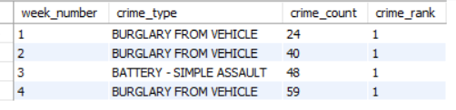
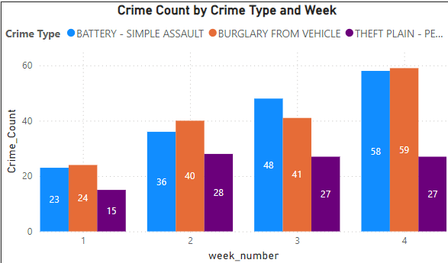
Observation
Problem statement 1: Which was the most frequent crime committed each week?
Result:
Observation :
In week 1 , 2 & 4 ,the most frequent crime is Burglary from Vehicle consisting of 131 crime reports .
In week 3, the most frequent crime is Battery(simple assault) consisting of 48 reported crimes.

Slide 5
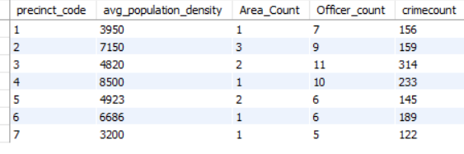
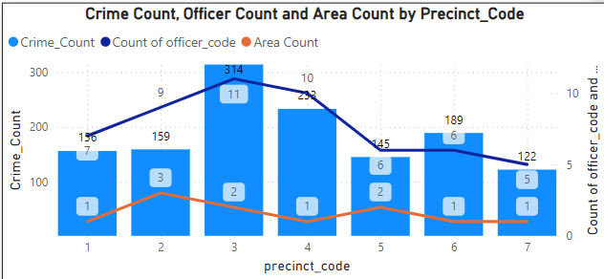
Problem statement 2: Is crime more prevalent in areas with a higher population density, fewer police personnel, and a larger precinct area?
Result:
Observation:
There is a significant spike in crime count in Precinct 3, reaching around 300 reports having 11 officers and large area.
Precinct 1 and 4 also have a relatively high crime count, above 200 having 156 & 233 reports respectively with total of 17 officers in both areas.
The lowest crime reports is observed in Precinct 7, at around 122.
The officer count seems to be relatively low compared to the crime reports in most precincts.

Slide 6
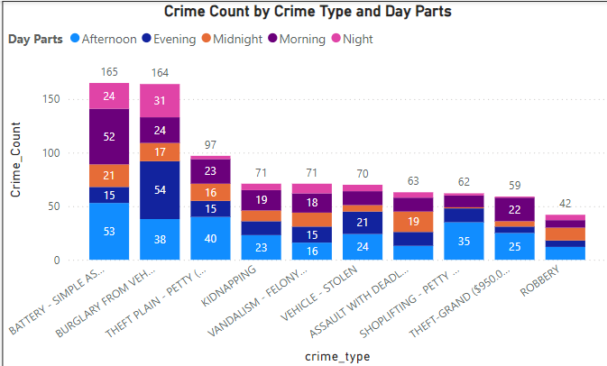
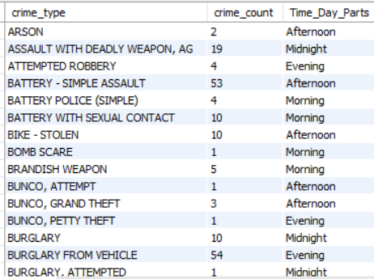
Problem statement 3: At what points of the day is the crime rate at its peak? Group this by the type of crime.
Result:
Observation:
Most of the crimes are committed during Afternoon across multiple crime types.
Morning day part shows the 2nd highest crime counts across most crime types.
Evening day part also has high crime reports for several crime types, particularly Kidnapping vehicle-related offenses ( Kidnapping, Burglary from Vehicle, Vehicle Stolen etc.).
Midnight & Night day part also has high crime counts for several crime types, particularly vehicle-related offenses (Burglary from Vehicle, Vehicle Stolen, Vandalism etc.).

Slide 7
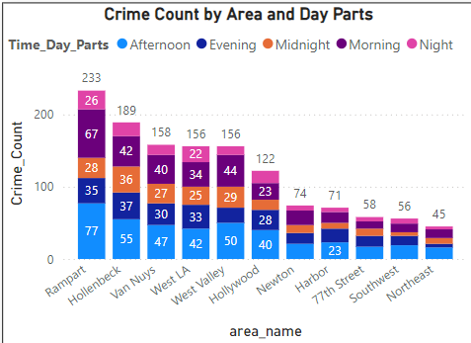
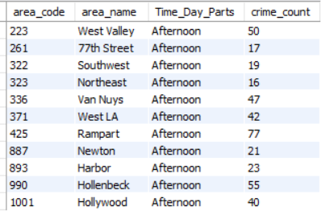
Problem statement 4: At what point in the day do more crimes occur in a different locality?
Result:
Observation:
Most of the crime area committed during Afternoon and morning in the all Localities (407 reports) .
Rampart shows highest crime reports ,with most incidents occurring in the Afternoon (77).
Hollenbeck shows 2nd highest crime reports ,with most incidents occurring during Afternoon (55).
Van Nuys, West LA & West Valley shows moderate crime reports, with most incident occurring during Afternoon respectively (around 40 -50 reports each) .
77th Street, Southwest & Northeast shows a low crime reports, with most incidents occurring in the Afternoon and Evening.

Slide 8
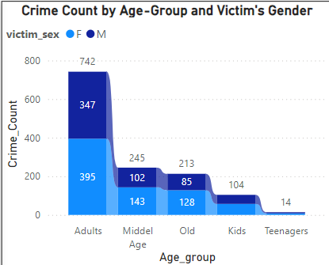
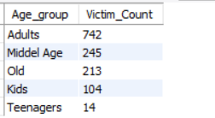
Problem statement 5: Which age group of people is more likely to fall victim to crimes at certain points in the day?
Result:
Observation:
Adults age-group has the highest number of victims, around 742 individuals.
Middle Age age-group has the 2nd highest number of victims, around 243 individuals.
Old age-group has the 3rd highest number of victims, around 213 individuals.
Kids age-group also has moderate number of victims, around 104.
Teenagers are the age-group having least number of victims (14 individuals).

Slide 9
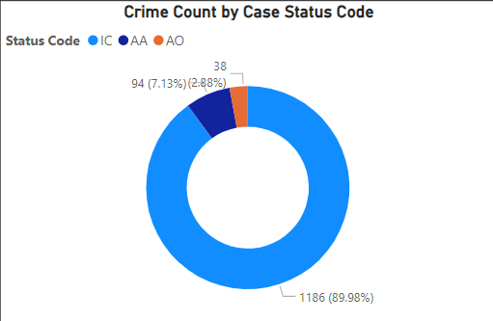

Problem statement 6: What is the status of reported crimes?
Result:
Observation:
Most of the reported crimes has IC (Investigation Continues) status code around 1190.
AA (Adult Arrest) status code has a count of 94 from reported cases.
AO (Adult Other) having least count of reported case (38) under this status.

Slide 10
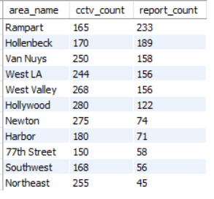
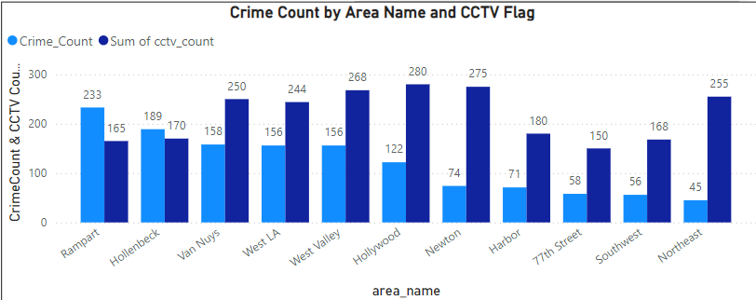
Problem statement 7: Does the existence of CCTV cameras deter crimes from happening?
Result:
Observation:
Rampart and 77the street having lowest number of cctv (165 & 150)while having highest Reported crimes in Rampart (233).
Hollenbeck having 2nd highest reported crimes(189) while having 170 cctv in the area.
Hollywood, Newton, West Valley, Van Nuys, West LA, Northeast having approx. same number of cctv in the area (around 270) while having moderate number of reported crimes (Highest crime count – 189 & lowest 45).

Slide 11

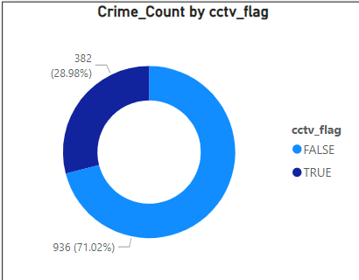
Problem statement 8: How much footage has been recovered from the CCTV at the crime scene?
Result:
Observation:
382 footages are recovered from cctv from the crime scene (approx. 29%).
936 footages are not recovered from cctv from the crime scene (approx. 71%).

Slide 12
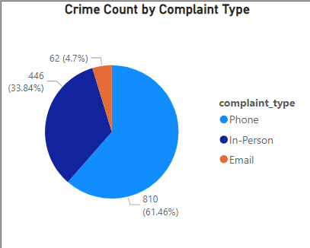
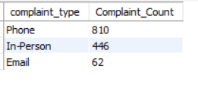
Problem statement 9: What are the methods used by the public to report a crime?
Observation:
Most of the crimes are reported through phone (810 complaints).
While considerable number of people prefer to report crimes in person (446 complaints).
email is the least preferred channel for reporting crimes as number of peoples reported through email are less than 5% (62).

Slide 13
Insights
Most of the crimes are committed during the last week (4) with Battery-Simple assault & Burglary from vehicles having most reported crimes. 1st Week having least crime reports and 2nd and 3rd week having moderate number of reported crimes.
Precinct 3 have highest crime reports while having 2 areas and 11 officers under it. while precinct 7 have lowest crime reports while having only 1 area and 5 officers under it. From this, we can say that having more areas & high population density results in more crime occurrence.
Most of the crimes Occurs during Morning & Afternoon for crimes such as Burglary from Vehicle, Vehicle Stolen, Vandalism Kidnapping etc. while night & midnight having lowest reports.
Rampart & Hollenbeck areas having most crime reports (approx.31%) during Afternoon & Morning while Northeast having lowest crimes reports.
Adults are most frequently victims in crimes (742), most likely due to increased exposure to potential risks stemming from their lifestyles and activities. While Kids & Teenagers having lower victims counts compared to other age-groups.
Majority of the cases (1186 approx. 89%) having status code having IC which means case is still under investigation. While AA indicates Arrests are made in considerable number(94 approx. 7% ) & AO status code indicate that fewer cases result in outcomes other than arrest or continued investigation (38 approx. 3%).
Having High number of CCTV in an area leads to lows Crimes, such as Hollywood, Newton, West Valley having approx. same number of CCTV in the area (around 270) while having moderate number of reported crimes (Highest crime count – 189 & lowest 45). While Rampart having lowest number of CCTV (165 & 150) leads to highest Reported crimes in Rampart (233).This suggests a correlation between lower CCTV coverage and higher crime rates.
Only 29% (382 out of 1318) total footages were recovered from CCTV at the crime scene. This indicates the delay in evidence collection by officers due to technical problems.
Most of the Cases are reported through phones (approx. 61%). And email is least preferred method for reporting. Which means Phone calls are the most convenient method for reporting crimes, as they can be made quickly and easily from anywhere.

Slide 14
Recommendations
Assigning Officer in a precinct according to area size & Population Density can lead to lower crime rate.
Increasing Patrols during Morning, Afternoon & at Night as most crimes are committed during these day parts. most Crimes such as burglary, vehicle related, Kidnapping are committed during these day periods.
Deploying more CCTV and Patrolling officers in area where Crime rate is high, as areas with less CCTV in have more crime reports.
Governments and organizations should conduct public awareness campaigns focusing on crime prevention and safe behaviors tailored for different age-groups especially adult as adults faces higher risk due to certain professions (e.g., night-shift workers, delivery drivers) and activities.
Introducing better technologies for faster evidence gathering, ensure redundant backup system for evidence in case of data loss, regular maintenance of CCTV for malfunction prevention. This can help in better evidence gathering for case procession.

Slide 15
KPIs
Reported Crimes
1318
Officer Count
54
Types of Crime
62
Number of Areas
11
Crime Status
IC
1186
AA
94
AO
38

